Slide 1
Zomato Food Delivery & Recommendation

Slide 2
TEAM Members
Saket Suhane
Achal Singh
Pranav Pramod
Venkatesh Nayak

Slide 3
Project Journey
Phase 1
Phase 2
Phase 3
Phase 4
Deployment of Model with help of HTML
Scrapped the data with the help of Beautiful Soup and Selenium
Understanding the problem statement and started working on web scrapping
Cleaned the Raw data and started working on model prediction

Slide 4
Problem Statement
Scrape data from food delivery platform Zomato using python library and collect information.
After that, build a recommendation model for someone who wants to open a restaurant in Bangalore.
ZOMATO

Slide 5
Approach
Web Scrapping
Model Building
Data Preprocessing
Model Deployment
Worked on different models and Random Forest was the best suitable
Scrapped the data using Beautiful soup and Selenium for scrolling
Cleaning the Raw data using Numpy, Panadas and Excel
Deployed the model on HTML webpage

Slide 6
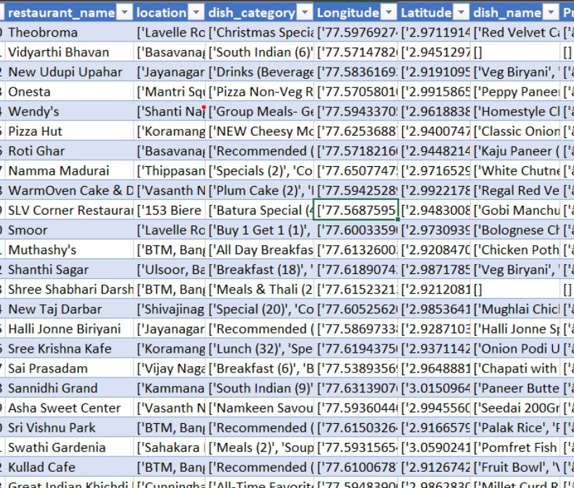
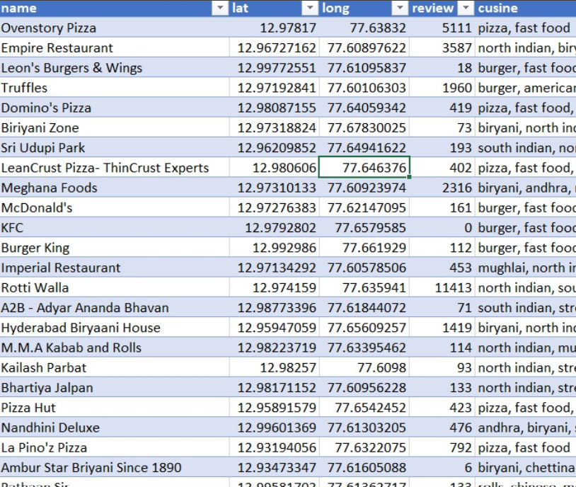
Data Preprocessing
Before
After

Slide 7
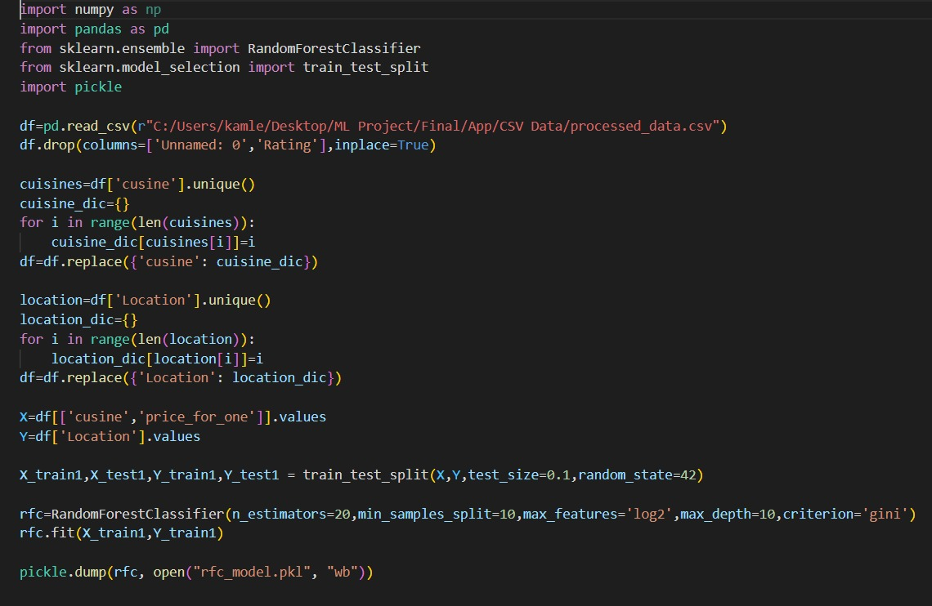
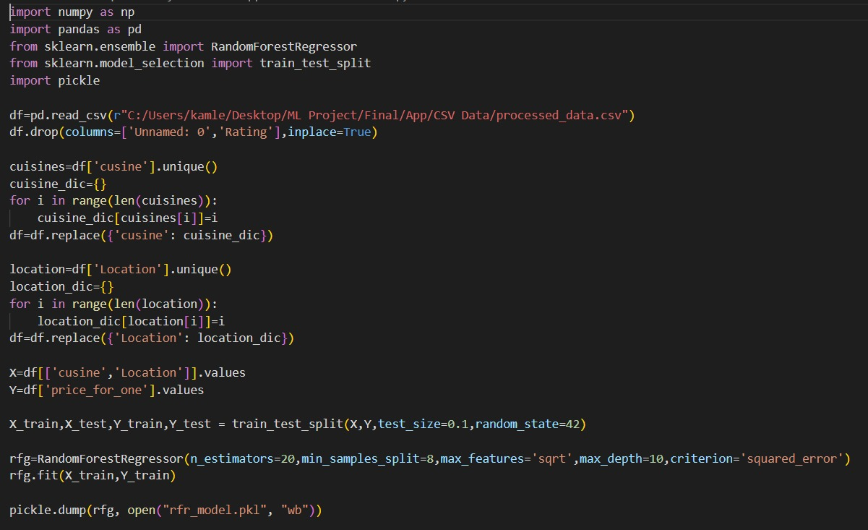
Modelling
Random Forest Classifier
Random Forest Regressor

Slide 8
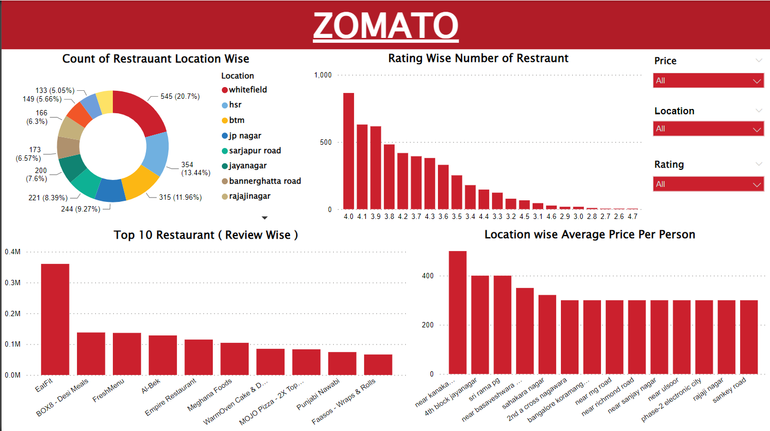
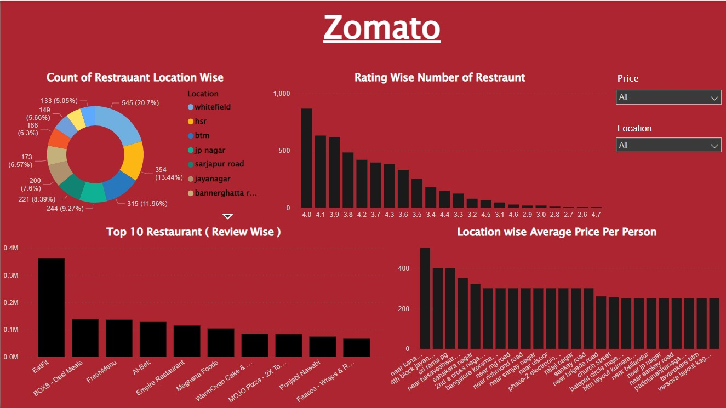
Dashboard Insights

Slide 9
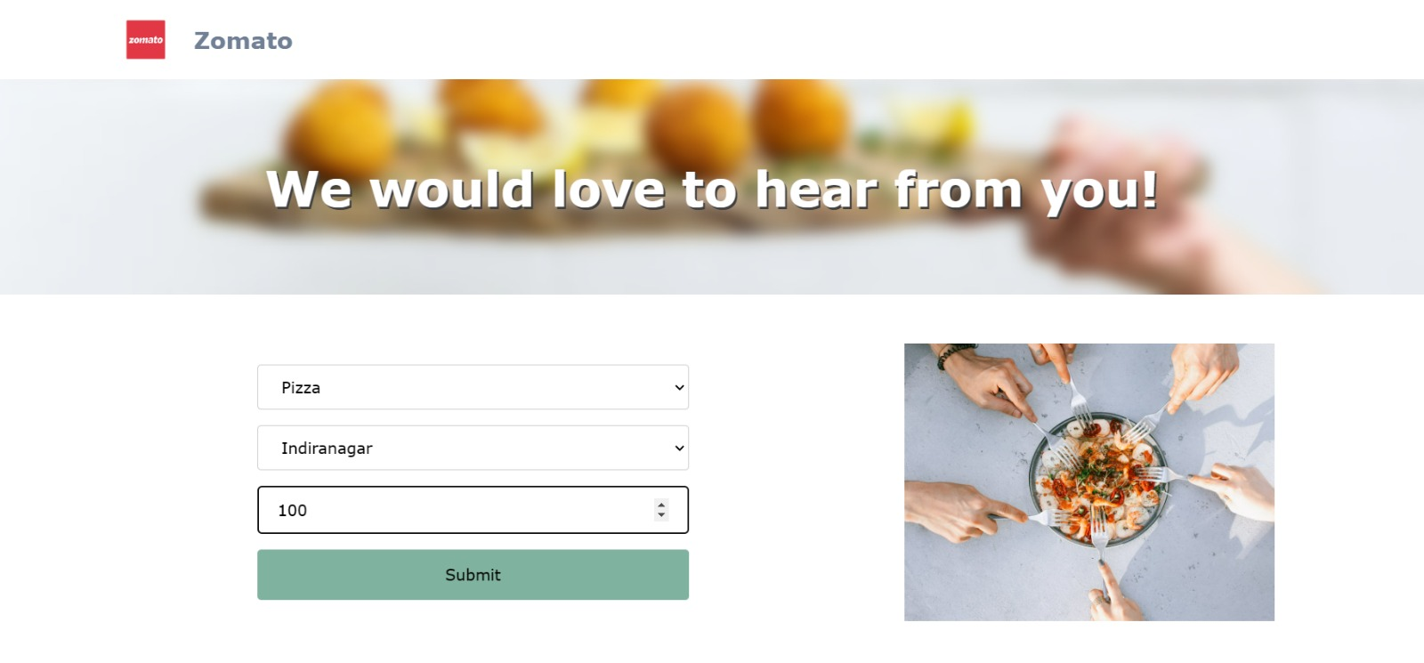
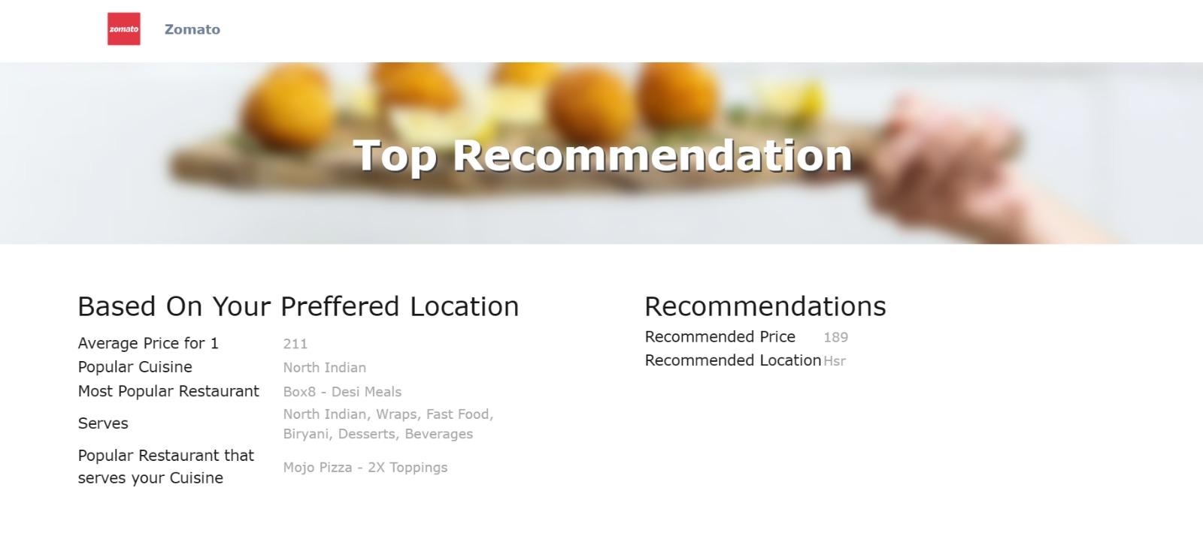
Input
Output
Model Deployment
We need to provide Cuisine, Price and preferred location to get the recommendation
Here we can get famous restaurants, Average prices and also the recommended Price and Location

Slide 10
Input Webpage

Slide 11
Recommendation Page

Slide 12
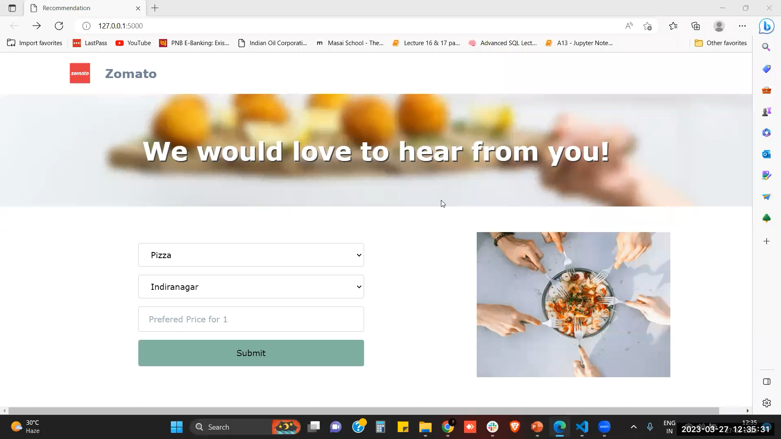
Product Demo

Slide 13
Challenges
Learning the different tools for data scraping
Data cleaning, analyzing and generating insights with the help of the dashboard
Dynamic Page scrolling was another issue faced
Finding the Xpath and reading the HTML file

Slide 14
Conclusion
We were able scrape the Zomato website successful and were able to extract around 3000 records.
The dataset which was recovered after web scraping were very less correlated to the target label. There was a lot of noise in the data as well.
Due to less features and lower correlation between the features and the label, the model was having very low accuracy.
If there were more number of features and higher co-linearity between the features and the target label, the model would may had higher accuracy.

Slide 15
Future Scope
The future scope of this project would deal with the successful recommendation of restaurants or any other activity for that matter. Taking the input of customers and based on said input, provide insights as to where their ideal place would be and what exactly is the price, etc.

Slide 16
Thank You
Do you have any questions?

